Slide 1
Various Architectural Patterns
—— 2016/5
77

Slide 2
Outline
Model-View-Controller Pattern
Pipe-and-Filter Pattern
Peer-to-Peer Pattern
Service-Oriented Architecture Pattern
Publish-Subscribe Pattern
Map-Reduce Pattern
Summary
77

Slide 3
1. Model-View-Controller Pattern
The Model-View-Controller pattern belongs to the component and connector patterns
The MVC pattern breaks system functionality into three components: a model, a view, and a controller that mediates between the model and the view
77

Slide 4
1.1 The Structure of MVC Pattern
Model
Encapsulates application state
Responds to state queries
Exposes application functionality
Notifies views of change
State Query
State Change
Change Notification
View
Renders the models
Requests updates from models
Sends user gestures to controller
Allows controller to select view
View Selection
Controller
Defines application behavior
Maps user actions to model updates
Selects view for response
One for each functionality
User Gestures
Key:
Method Invocations
The MVC pattern
Events
77

Slide 5
1.2 Context of MVC Pattern
User interface software is typically the most frequently modified portion of an interactive application
To keep modifications to the user interface software separate from the rest of the system
User wish to look at data from different perspectives, such as a bar graph or a pie chart
77

Slide 6
1.3 Problem of MVC Pattern
How can user interface functionality be kept separate from application functionality and yet still be responsive to user input, or to changes in the underlying application’s data?
How can multiple views of the user interface be created, maintained, and coordinated when the data changes
77

Slide 7
1.4 Solution of MVC Pattern
The MVC pattern separates application functionality into three kinds of components:
A model, which contains the data
A view, which displays some portion of the data and interacts with the user
A controller, which mediates between the model and the view and manages the notifications of state changes
77

Slide 8
1.4.1 Elements of Solution
Element:
The model is a representation of the application data or state
The view is a user interface that either produces a representation of the model or allows for some form of user input
The controller manages the interaction between the model and the view, translating user actions into changes
77

Slide 9
1.4.2 Relations of Solution
Relations:
The notifies relation connects instances of model, view, and controller,
notifying elements of relevant state changes
77

Slide 10
1.4.3 Constraints of Solution
Constraints:
There must be at least one instance each of model, view, and controller
77

Slide 11
1.4.4 Weaknesses of Solution
Weaknesses
The complexity my not be worth it for simple user interfaces
The model, view, and controller abstractions may not be good fits for some user interface toolkits, some commercial user interface toolkits combined input and output into individual widgets
77

Slide 12
1.4.5 Advantage of Solution
Advantages:
Because these components are loosely coupled, it easy to develop and test them in parallel, and changes to one have minimal impact on the others
Question: What quality attributes does the MVC pattern support?
77

Slide 13
1.4.6 Application of MVC Pattern
MVC pattern has wide application in user libraries
Java’s Swing classes
Microsoft’s ASP.NET framework
Adobe’s Flex software development kit
Nokia’s Qt framework
It is common for a single application to contain many instances of MVC
77

Slide 14
2. Pipe-and-Filter Pattern
The Pipe-and-Filter pattern belongs to the component and connector patterns
The Pipe-and-Filter pattern transforms data from a system’s external inputs to its external outputs through a series of transformations performed by its filters connected by pipes.
77

Slide 15
2.1 The Structure of Pipe-and-Filter Pattern
《filter》
《filter》
:Calculate
DirectDeposit
:Format
DerectDeposit
《filter》
《pipe》
《filter》
:XmlToObject
out
in
:Process
Payment
《filter》
:FormatRejected
Records
Capacity = 50
End-of-data = “EOT” string
When-full = black for 2 sec and retry
When-empty = block for 20 sec and retry
A UML diagram of a pipe-and-filer-based system
77

Slide 16

2.2 Context of Pipe-and-Filter Pattern
Many systems are required to transform streams of discrete data items from input to output
Many types of transformations occur repeatedly in practice, and so it is desirable to create these as independent, reusable parts
77

Slide 17
2.3 Problem of Pipe-and-Filter Pattern
Such systems need to be divide into reusable, loosely coupled components with simple, generic interaction mechanisms
The components can be flexibly combined with each other
The components are easily reused
The components, being independent, can execute in parallel
77

Slide 18
2.4 Solution of Pipe-and-Filter Pattern
The Pipe-and-Filter pattern is characterized by successive transformations of streams of data
Data arrives at a filters input port(s), is transformed, and then is passed via its output port(s) through a pipe to the next filter
A single filter can consume data from, or produce data to, one or more ports
77

Slide 19
2.4.1 Elements of Solution(1)
Filter:
Filter, which is a component that transforms data read on its input port to data written on its output port
Filter can execute concurrently
Filter can incrementally transform data
Characteristics：processing rates, input/output data formats and transformation
77

Slide 20
2.4.1.1 Elements of Solution(2)
Pipe:
Pipe, which is a connector that conveys data from a filter’s output port to another filter’s input port
A pipe has a single source and a target
A pipe preserves the data
Characteristics：buffer size, protocol of interaction, transmission speed, and format of the data
77

Slide 21
2.4.2 Relations of Solution
Relations:
The attachment relation associates the output of filters with the input of pipes and vice versa
77

Slide 22
2.4.3 Constraints of Solution
Constraints:
Pipes connect filter output ports to filter input ports
Connected filters must agree on the type of data being passed along the pipe
Some specializations may prescribe that components have certain named ports, such as the stdin, stdout, and stderr ports of UNIX filter
77

Slide 23
2.4.4 Weaknesses of Solution
The pipe-and-filter pattern is typically not a good choice for interactive system
Having large numbers of independent filters can add computational overhead
Pipe-and-filter systems may not be appropriate for long-running computations
As the failure of any filter (or pipe) can cause the entire pipeline to fail
77

Slide 24
2.4.5 Application of Pipe-and-Filter Pattern
Pipe-and-filter pattern has wide application
Data transformation systems, such as stream of video
The signal-processing applications
UNIX pipes: Apache web server, the map-reduce pattern, Yahoo pipes for processing RSS feeds, many workflow engines
77

Slide 25
3. Peer-to-Peer Pattern
The Peer-to-Peer pattern belongs to the component and connector patterns
The peer-to-peer pattern achieves computation by cooperating pees that request service from and provide services to one another across a network
77

Slide 26
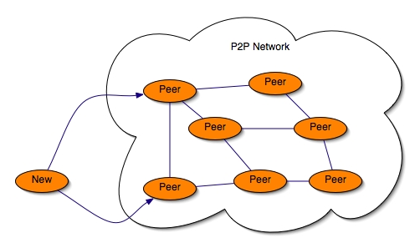
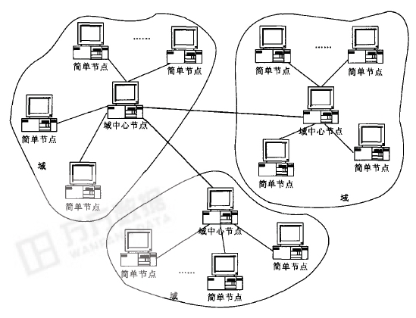
3.1 The Structure of Peer-to-Peer Pattern
Pure P2P structure
Domain P2P structure
The peer-to-peer pattern
77

Slide 27
3.2 Context of P2P Pattern
Distributed computational entities, each of which is considered equally important in terms of initiating an interaction
Each of entities provides its own resources for a service to a distributed community of users
77

Slide 28
3.3 Problem of P2P Pattern
How can a set of equal distributed computational entities be connected to each other via a common protocol so that they can organize and share their services with high availability and scalability
77

Slide 29
3.4 Solution of P2P Pattern
In the P2P pattern, components directly interact as peers
All peers are equal
No peer or group of peers can be critical for the health of the system
Each peer component is both a client and a server
Each peer provides and consumes similar services and uses same protocol
77

Slide 30
3.4.1 Elements of Solution
Element:
Peer, which is an independent component running on a network node. Special peer components can provide routing, indexing, and peer search capability
Request/replay connector, which is used to connect to the peer network, search for other peers, and invoke services
77

Slide 31
3.4.2 Relations of Solution
Relations:
The relation associates peers with their connector
Attachments may change at runtime
77

Slide 32
3.4.3 Constraints of Solution
Constraints:
The number of allowable attachments to any given peer
The number of hops used for searching for a peer
Which peers know about which other peers
In star topologies, peers only connect to supernodes
77

Slide 33
3.4.4 Weaknesses of Solution
Weaknesses
Managing security, data consistency, data/service availability, backup, and recovery are all more complex
Small P2P systems may not be able to consistently achieve quality goals such as performance and availability
77

Slide 34
3.4.5 Advantage of Solution
Advantages:
Scalability: peers can be added and removed with no significant impact
Availability: multiple peers provide equivalent services
Performance: multiple peers have overlapping capabilities, the load on any given peer component acting as a server is reduced
77

Slide 35
3.4.6 Application of P2P Pattern
P2P pattern is often used in distributed computing applications
File sharing: BitTorrent and eDonkey
Instant messaging: Skype
Desktop grid computing
Routing
Wireless ad hoc networking
77

Slide 36
4. Service-Oriented Architecture Pattern
The service-oriented architecture (SOA) pattern belongs to the component and connector patterns
The SOA pattern achieves computation by a set of cooperating components that provide and/or consume services over a network
The computation is often described using a workflow language
77

Slide 37
4.1 The Structure of SOA Pattern
WSDL, SOAP, and
UDDI(Universal Description, Discovery and Integration)
UDDI
Registry
3. Locate UDDI
2. Register UDDI
Web Service
Requestor
Web Service
Provider
4. Invoke SOAP
The SOA pattern
1. Interface WSDL
77

Slide 38
4.2 Context of SOA Pattern
A number of services are offered by service providers and consumer by service consumers
Service consumers need to be able to understand and use these services without any detailed knowledge of their implementation
77

Slide 39
4.3 Problem of SOA Pattern
How can we support interoperability of distributed components running on different platform and written in different implementation languages, provided by different organizations, and distributed across the Internet
How can we locate services and combine them into coalitions while achieving performance, security, and availability
77

Slide 40
4.4 Solution of SOA Pattern
The SOA pattern describes a collection of distributed components that provide and/or consume services
Services are largely standalone: service provides and service consumers are usually deployed independently
77

Slide 41
4.4.1 Elements of Solution
Element:
Service providers
Service consumers
Enterprise service bus ( ESB )
Registry of services
Orchestration server
Connector
77

Slide 42
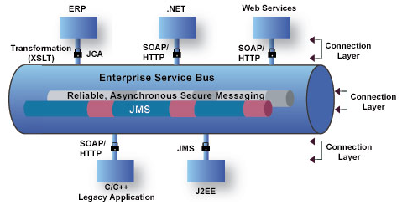
4.4.1.1 Enterprise Service Bus ( ESB )
ESB, which is an intermediary that can route and transform messages between service providers and consumers
ESB can convert messages from one protocol or technology to another
77

Slide 43
4.4.1.2 Connectors
The basic types of connectors used in SOA are these:
SOAP connector, which uses the SOAP protocol for synchronous communication between web services
REST(Representational State Transfer) connector, which relies on the basic request/replay operations
Asynchronous messaging connector, which uses a messaging system
77

Slide 44
4.4.2 Relations of Solution
Relations:
Attachment of the different kinds of components available to the respective connectors
77

Slide 45
4.4.3 Constraints of Solution
Constraints:
Service consumers are connected to service providers, but intermediary components ( e.g., ESB, registry, orchestration server) may be used
77

Slide 46
4.4.4 Weaknesses of Solution
Weaknesses
SOA-based systems are typically complex to build
You don’t control the evolution of independent services
There is a performance overhead a associated with the middleware, and services may be performance bottlenecks
77

Slide 47
4.4.5 Advantage of Solution
Advantages:
Interoperability: because service provides and service consumers may run on different platforms, service-oriented architectures often integrate a variety of systems
Question: What quality attributes does the SOA pattern support also?
77

Slide 48
4.4.6 Application of SOA Pattern
SOA pattern has wide application
IBM’s WebSphere MQ (Message Queue)
Microsoft’s MSMQ
Apache’s Active MQ
77

Slide 49
5. Publish-Subscribe Pattern
The publish-subscribe pattern belongs to the component and connector patterns
In the publish-subscribe pattern, the components publish and subscribe to events
When an event is announced by a components, the connector infrastructure dispatches the event to all registered subscribers
77

Slide 50
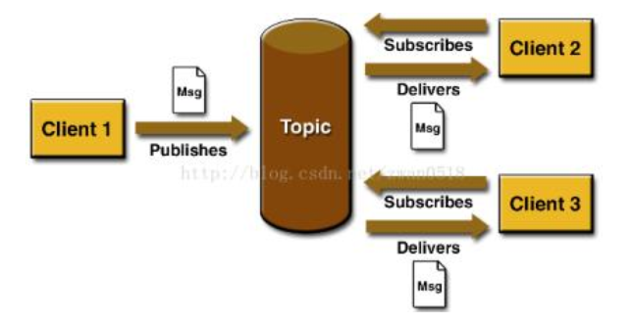
5.1 The Structure of Publish-Subscribe Pattern
The publish-subscribe pattern
77

Slide 51
5.2 Context of Publish-Subscribe Pattern
There are a number of independent producers and consumers of data that must interact
The precise number and nature of the data producers and consumers are not predetermined or fixed, nor is the data that they share
77

Slide 52
5.3 Problem of Publish-Subscribe Pattern
How can we create integration mechanisms that support the ability to transmit messages among the producers and consumers in such a way that they are unaware of each other’s identity, or potentially event their existence?
77

Slide 53
5.4 Solution of Publish-Subscribe Pattern
In the publish-subscribe pattern, components interact via announced messages, or events
Components may subscribe to a set of events
77

Slide 54
5.4.1 Elements of Solution
Element:
Any C&C component with at least one publish or subscribe port
The publish-subscribe connector, which will have announce and listen roles for components that wish to publish and subscribe to events
77

Slide 55
5.4.2 Relations of Solution
Relations:
The attachment relation associates components with the publish-subscribe connector by prescribing which components announce events and which components are registered to receive events
77

Slide 56
5.4.3 Constraints of Solution
Constraints:
All components are connected to an event distributor
Publish ports have announce roles and subscribe ports have listen roles
How many publish-subscribe connectors can exist within a system
77

Slide 57
5.4.4 Weaknesses of Solution
Weaknesses
Increases latency
has a negative effect on salability and predictability of message delivery time
Less control over ordering of messages
Delivery of messages is not guaranteed
77

Slide 58
5.4.5 Advantage of Solution
Question:
What quality attributes does the publish-subscribe pattern support?
77

Slide 59
5.4.6 Application of Publish-Subscribe Pattern
Publish-subscribe pattern has wide application
Graphical user interfaces (GUI) system
MVC-based application
Enterprise resource planning (ERP) systems, which integrate many parts
Extensible programming environments
Mailing lists
77

Slide 60
6. Map-Reduce Pattern
The map-reduce pattern belongs to the allocation patterns
The map-reduce pattern provides a framework for analyzing a large distributed set of data that will execute in parallel, on a set of processors
This parallelization allows for low latency and high availability
77

Slide 61
6.1 The Structure of Map-Reduce Pattern
Portion i of
input file
Portion j of
input file
Map instance
i
Partition
1
Partition
2
Partition
3
Output
from
instance 2
Merge
Reduce
instance 2
Map instance
j
Partition
1
Partition
2
Partition
3
Key:
Component
Output
The map-reduce pattern
Disk file
77

Slide 62
6.2 Context of Map-Reduce Pattern
Businesses have a need to quickly analyze enormous volumes of data at petabyte scale, such as social network site logs, pairs of <source, target> web links for a search engine
Programs for the analysis of this data should be easy to write, run efficiently, and be resilient with respect to hardware failure
77

Slide 63
6.3 Problem of Map-Reduce Pattern
For many applications with ultra-large data set, sorting the data and then analyzing the grouped data is sufficient
The problem map-reduce pattern solves is to efficiently perform a distributed and parallel sort of large data set and provide a simple means for the programmer to specify the analysis to be done
77

Slide 64
6.4 Solution of Map-Reduce Pattern
The map-reduce pattern requires three parts
A specialized infrastructure take care of allocating software to the hardware nodes in a massively parallel computing environment and handles sorting the data as needed
Map
Reduce
77

Slide 65
6.4.1 Elements of Solution
Element:
Map is a function with multiple instances deployed across multiple processors
Reduce is a function that may be deployed as a single or multiple instance
The infrastructure is the framework responsible for deploying map and reduce instances
77

Slide 66
6.4.1.1 Map Function
The purpose of map function is to filter and sort the data set
Key1: is used to filter the data
Key2: is used for sorting
Multiple map instances are used for performance, data set is divided into parts
Input:
(key1, data set)
Map
function
Output:
(key2, value)
77

Slide 67
6.4.1.2 Example of Map Function
map (String key, String value ) :
// key: document name
// value: document contents
For each word w in value:
Emit ( w, “1” );
Input: Having a whole book…
Output: <Having, 1>, <a, 1>, <whole, 1>, <book, 1>
77

Slide 68
6.4.1.3 Reduce Function
Reduce does some programmer-specified analysis and then emits the results
The output set is almost always much smaller than the input sets, hence the name “reduce”
Input:
(key2, values)
Reduce
function
Output:
Result
77

Slide 69
6.4.1.4 Example of Reduce Function
reduce (List <key, value> ) :
// key: a word
// value: an integer
// purpose: statistic the same word number
int result = 0;
sort input
for each input value:
for each input pair with same word
result++；
Emit ( word, result )
result = 0
77

Slide 70
6.4.2 Relations of Solution
Relations:
Deploy on is the relation between an instance of a map or reduce function and the processor onto which it is installed
Instantiate, monitor, and control is the relation between the infrastructure and the instances of map and reduce
77

Slide 71
6.4.3 Constraints of Solution
Constraints:
The data to be analyzed must exist as a set of files
The map functions are stateless and do not communicate with each other
The only communication between the map instances and the reduce instances is the data emitted from the map instances as <key, value> pairs
77

Slide 72
6.4.4 Weaknesses of Solution
Weaknesses
If you do not have large data sets, the overhead of ma-reduce is not justified
If you cannot divide your data set into similar sized subsets, the advantages of parallelism are lost
Operations that require multiple reduces are complex to orchestrate
77

Slide 73
6.4.5 Advantage of Solution
Question:
What quality attributes does the map-reduce pattern support?
77

Slide 74
6.4.6 Application of Map-Reduce Pattern
Map-reduce pattern has wide application
Google
Facebook
eBay
Yahoo
77

Slide 75
Summary
An architectural pattern establishes a relationship between:
A context
A problem
A solution
Constraint
Patters can be categorized by the dominant type of elements
There are various useful patter
77

Slide 76
Homework
SOA systems feature dynamic service registration and discovery. Which quality attributes does this capability enhance and which does it threaten
If you had to make a recommendation to your boss about whether your company’s SOA system should use external services it discovers at runtime, what would you say?
77

Slide 77
Discuss
How do you design your software using the architectural pattern and tactics you studied?
77

